Slide 1

Mouse fatigue detection training a Neural Network for Arduino in TensorFlow
Group 3:
Ben Gachette
Luis Marin Vera

Slide 2
Introduction
We hope this presentation helps you understand, how to train, and implement a Neural network to predict forearm muscle pain levels, using Tiny Machine Learning, Arduino, and Tensorflow Lite
Machine Learning is a branch of artificial intelligence, focused on building applications that learn from data and improve their accuracy over time.
Deep Learning is a subset of machine learning, that utilizes Deep artificial neural networks for learning from large amounts of data
Tiny Machine Learning or Tiny ML is an area of development in the AI world. It refers to the use of small, lightweight neural networks that can be deployed on resource-constrained devices like microcontrollers.

Slide 3
Introduction
GSR stands for galvanic skin response and is a method of measuring the skin's electrical conductance.
GSR allows you to spot such strong emotions by simply attaching two electrodes to two fingers on one hand. It is interesting to create emotion-related projects like sleep quality monitor.
EMG detector is a bridge that connects the human body and electrical, the sensor gathers small muscle signals then process with 2th amplify and filter, the output signal can be recognized by Arduino.

Slide 4
What is this Project about?
A mouse fatigue detection dataset will be trained via TensorFlow.
Sensors will be connected to the Arduino's Wio terminal to measure forearm muscle soreness levels based on GSR (galvanic skin response) and EMG (Electromyography) measurements.
The Wio Terminal will display the collected muscle soreness data from its integrated TFT LCD screen. Successfully trained, the screen should display the muscle soreness data in three levels:
Relaxed
Tense
Exhausted

Slide 5
What is this Project about?
After training and testing the neural network model:
We converted it from a TensorFlow Keras H5 model to a C array (.h file) to execute the model on Wio Terminal. Therefore, the device is capable of detecting precise forearm muscle soreness levels (classes) by running the model independently.
After scaling (normalizing) and preprocessing inputs, We obtained two input variables and one label for each data record in the data set.
GSR,EMG and Soreness Level
Then, We built an artificial neural network model with TensorFlow and trained it with the training data set to acquire the best results and predictions possible.
Focus on Supervised Learning a model uses the input to generate the appropriate output (the model sees the labels in training).

Slide 6
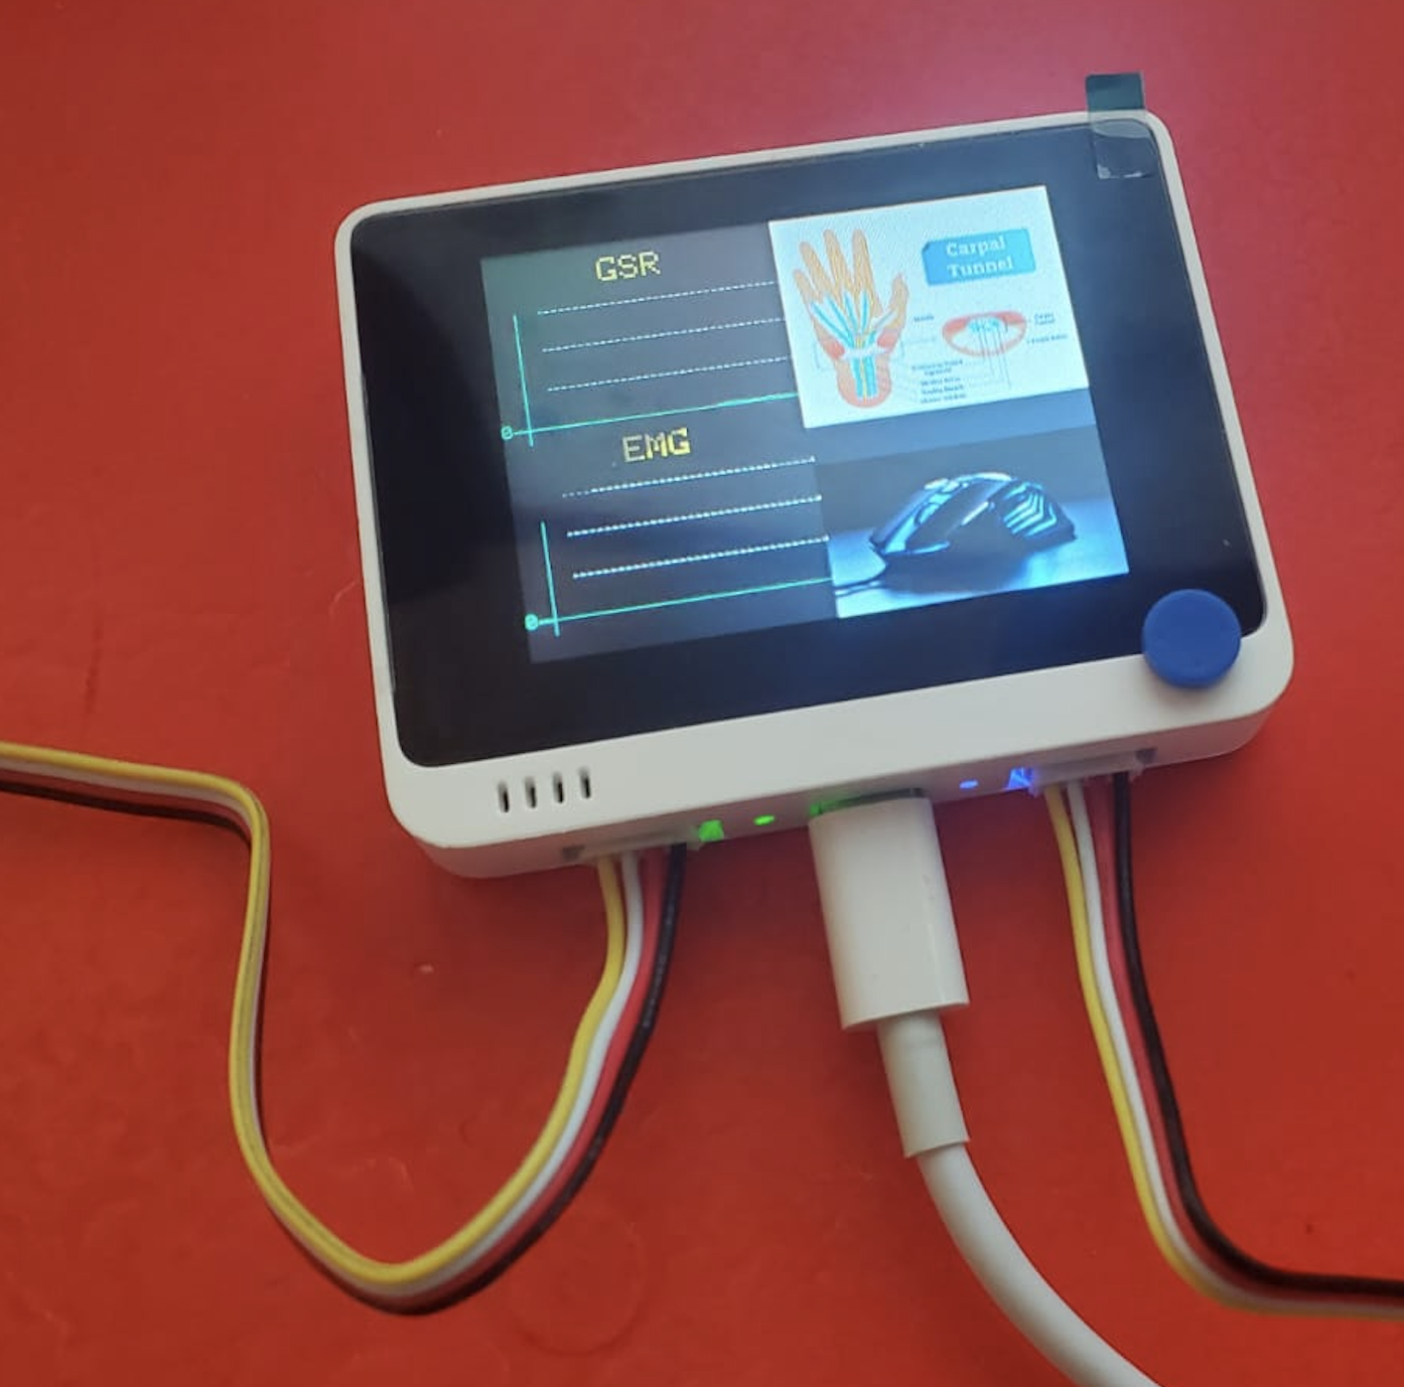
WIO Terminal: https://wiki.seeedstudio.com/Wio-Terminal-Getting-Started/

Slide 7
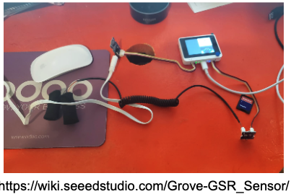
How to connect Galvanic skin response GSR sensor to WIO terminal

Slide 8
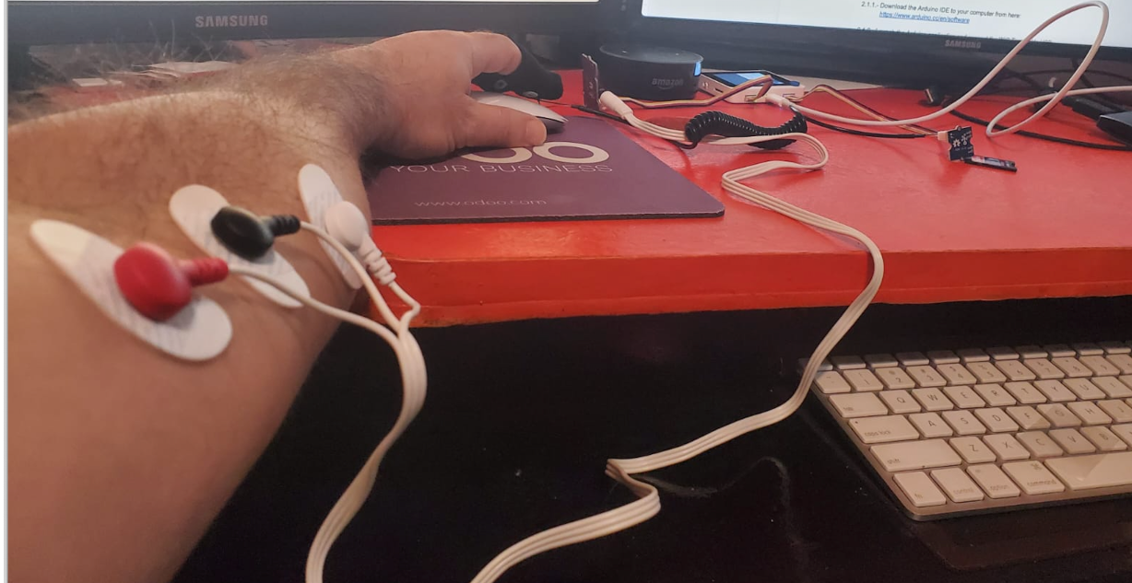
Finally, tack the three electrodes to your muscle, and keep a distance between each electrode.

Slide 9
Arduino IDE 1.8.19
Download the Arduino IDE to your computer from here: https://www.arduino.cc/en/software
Launch the Arduino application and connect the WIO Terminal to USB:
Double-click the Arduino IDE application you have previously downloaded.
Add WIO Terminal Board Library
Go to Arduino File | Preferences
Add Additional Boards Manager URL:
https://files.seeedstudio.com/arduino/package_seeeduino_boards_index.json

Slide 10
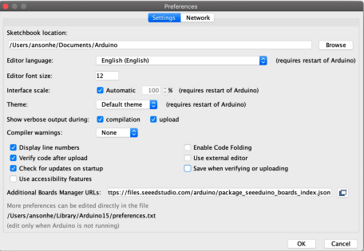
Add Additional Boards Manager URL:

Slide 11
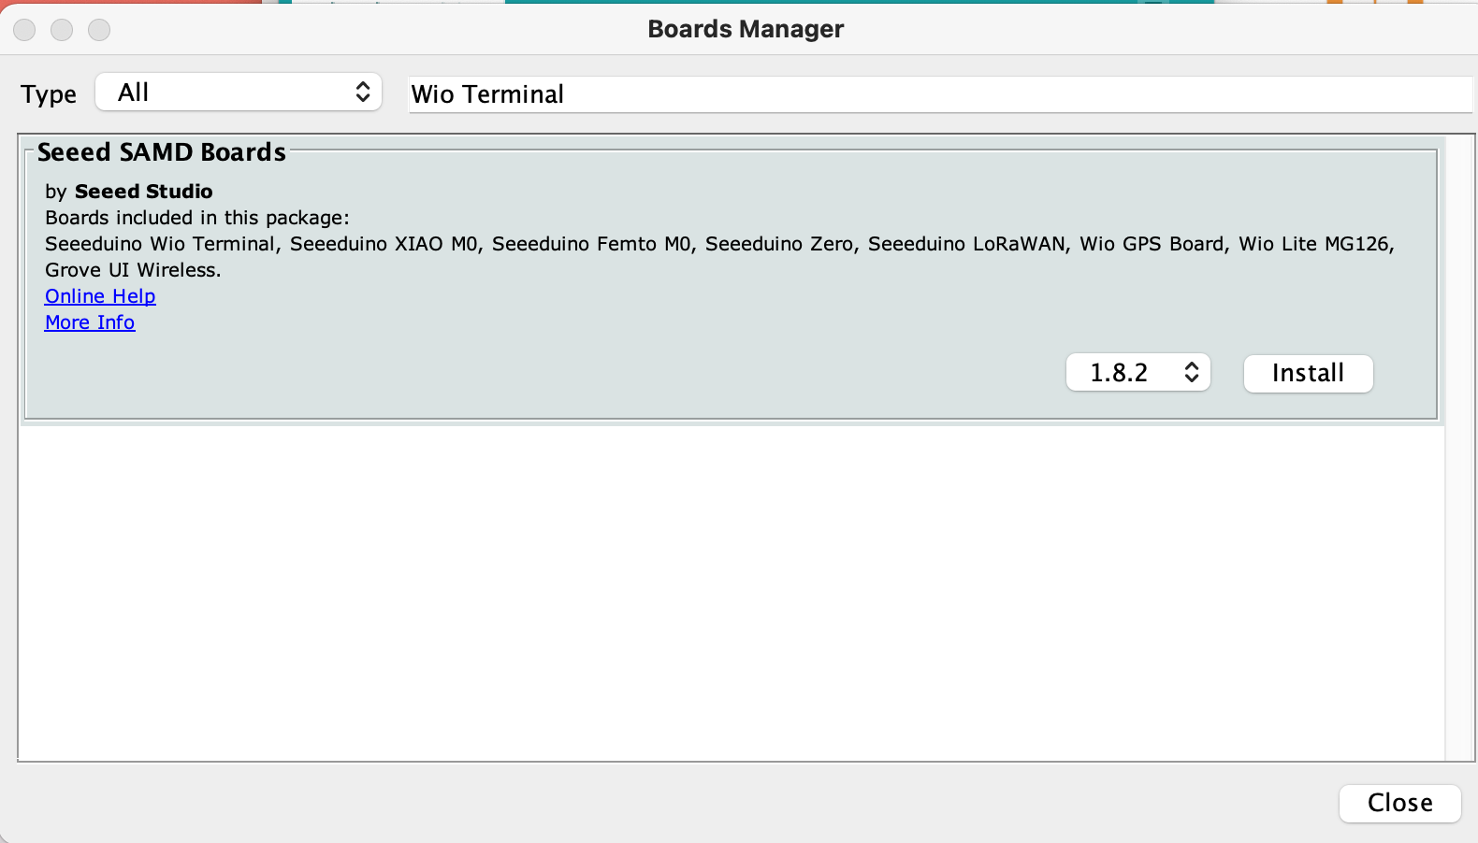
Set up the Seeed SAMD Arduino Core
Open the Arduino IDE, click Tools | Board | Boards Manager, and search for Wio Terminal in the search box. Then, install Seeed SAMD Boards

Slide 12
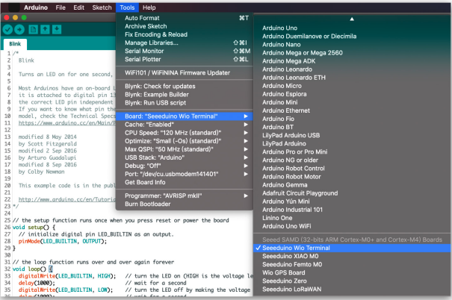
Check the Installed Seeed SAMD Boards

Slide 13
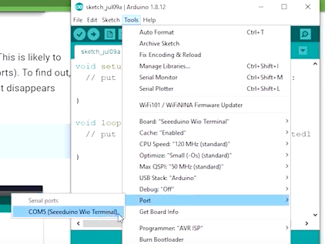
Selecting board and port
Select the Tools | Board menu entry that corresponds to your Arduino.
Select the Wio Terminal

Slide 14
Installing the SD Card library for Wio Terminal
This presentation introduces how to install the File System library used on Wio Terminal.
It provides the basic functionality of File operating with the SD card, allowing to Read/Write in or from the SD card using the SPI interface.

Slide 15
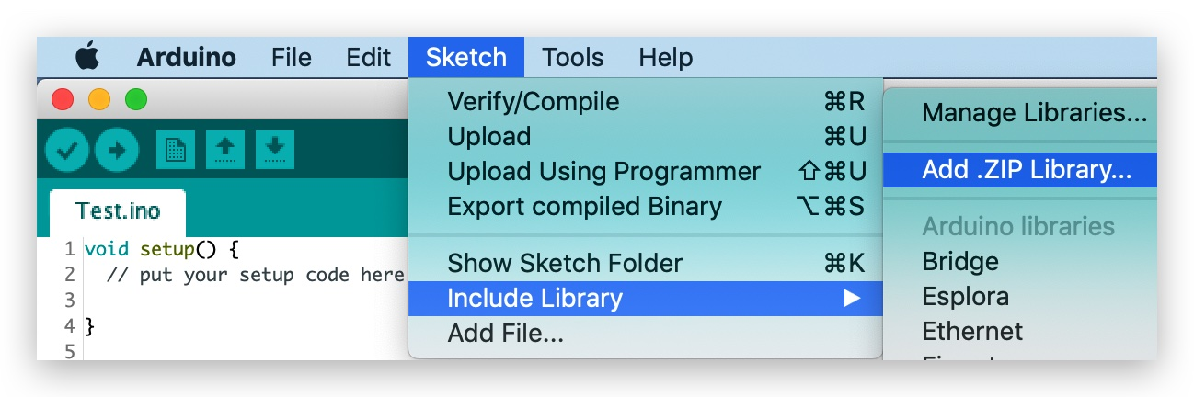
Installing the File System Library
Download the entire repo Seeed_Arduino_FS: https://github.com/Seeed-Studio/Seeed_Arduino_FS
Open the Arduino IDE: click sketch | Include Library | Add .ZIP Library, and choose the Seeed_Arduino_FS file that you have just downloaded.

Slide 16
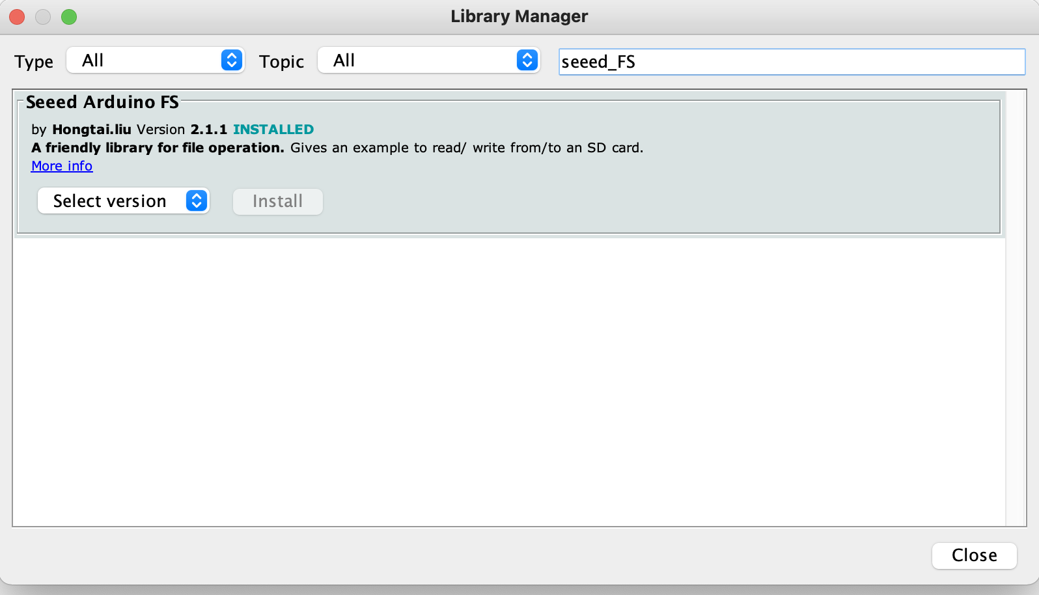
Check on sketch | Library Manager | Search for seeed_FS

Slide 17
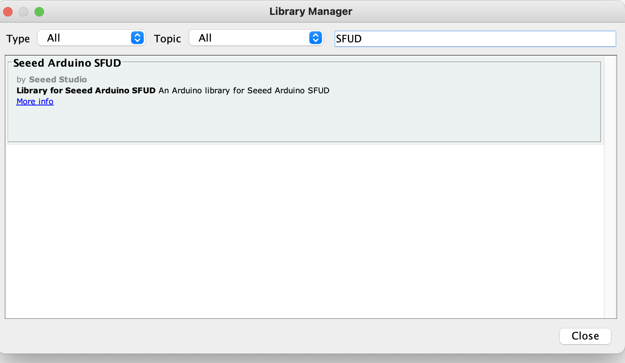
Install the Dependent SFUD Libraries
Download and Install the Library
https://github.com/Seeed-Studio/Seeed_Arduino_SFUD
Check on sketch | Library Manager | Search for SFUD

Slide 18
Install Seeed_Arduino_Linechart and TFT LCD Library Separately
Visit the Seeed_Arduino_LCD repositories and download the entire repo to your local drive.
https://github.com/Seeed-Studio/Seeed_Arduino_Linechart
https://github.com/Seeed-Studio/Seeed_Arduino_LCD
TFT LCD library can be installed to the Arduino IDE. Open the Arduino IDE, and click sketch | Include Library | Add .ZIP Library, and choose the Seeed_Arduino_Linechart, then Seeed_Arduino_LCD file that you've just downloaded

Slide 19
Install the project
To display the converted BMP files on the TFT LCD screen, move them to the SD card.
Then, copy the RawImage.h file to the sketches on the Arduino IDE.
https://files.seeedstudio.com/wiki/Wio-Terminal/res/RawImage.h
Now, simply click the Upload button in the environment. Wait a few seconds and if the upload is successful, the message "Done uploading." will appear in the status bar.

Slide 20
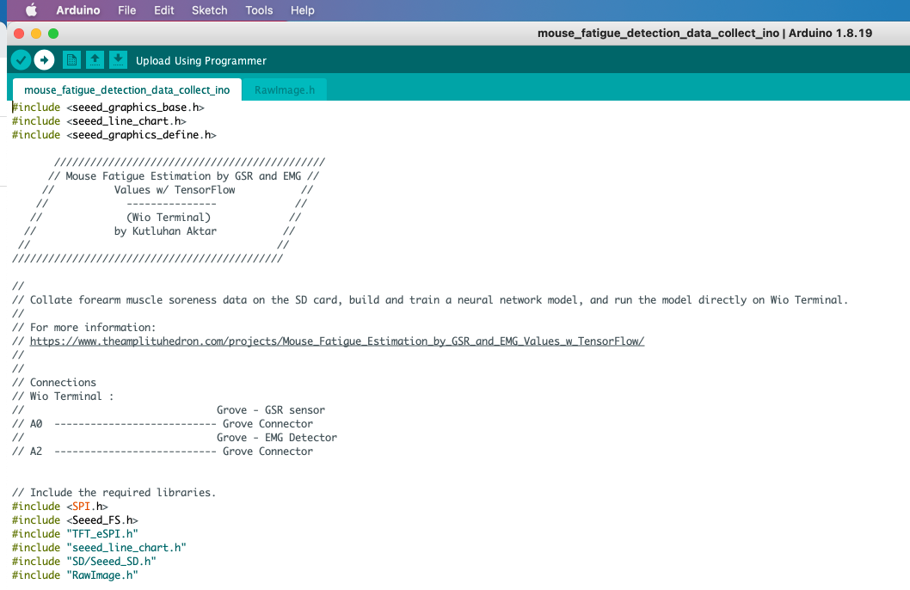
Uploading the program to the WIO Terminal

Slide 21
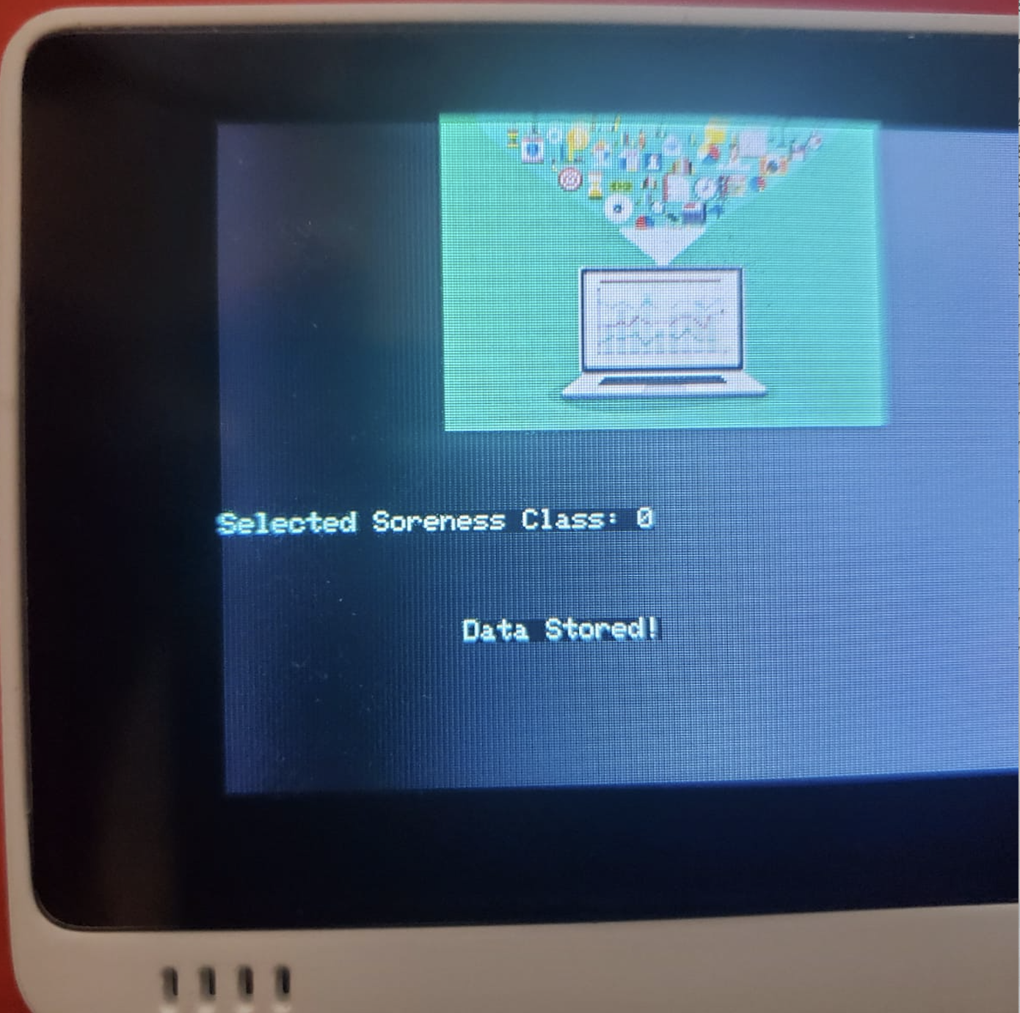
The device displays real-time GSR and EMG measurements as line charts on the TFT screen
If Button A (configurable button) is pressed, the device appends a new row (data record) to the mouse_fatigue_data_set.csv file on the SD card by adding the Relaxed [0] muscle soreness class under the Soreness data field. Then, if the device saves the data record successfully to the given CSV file on the SD card

Slide 22
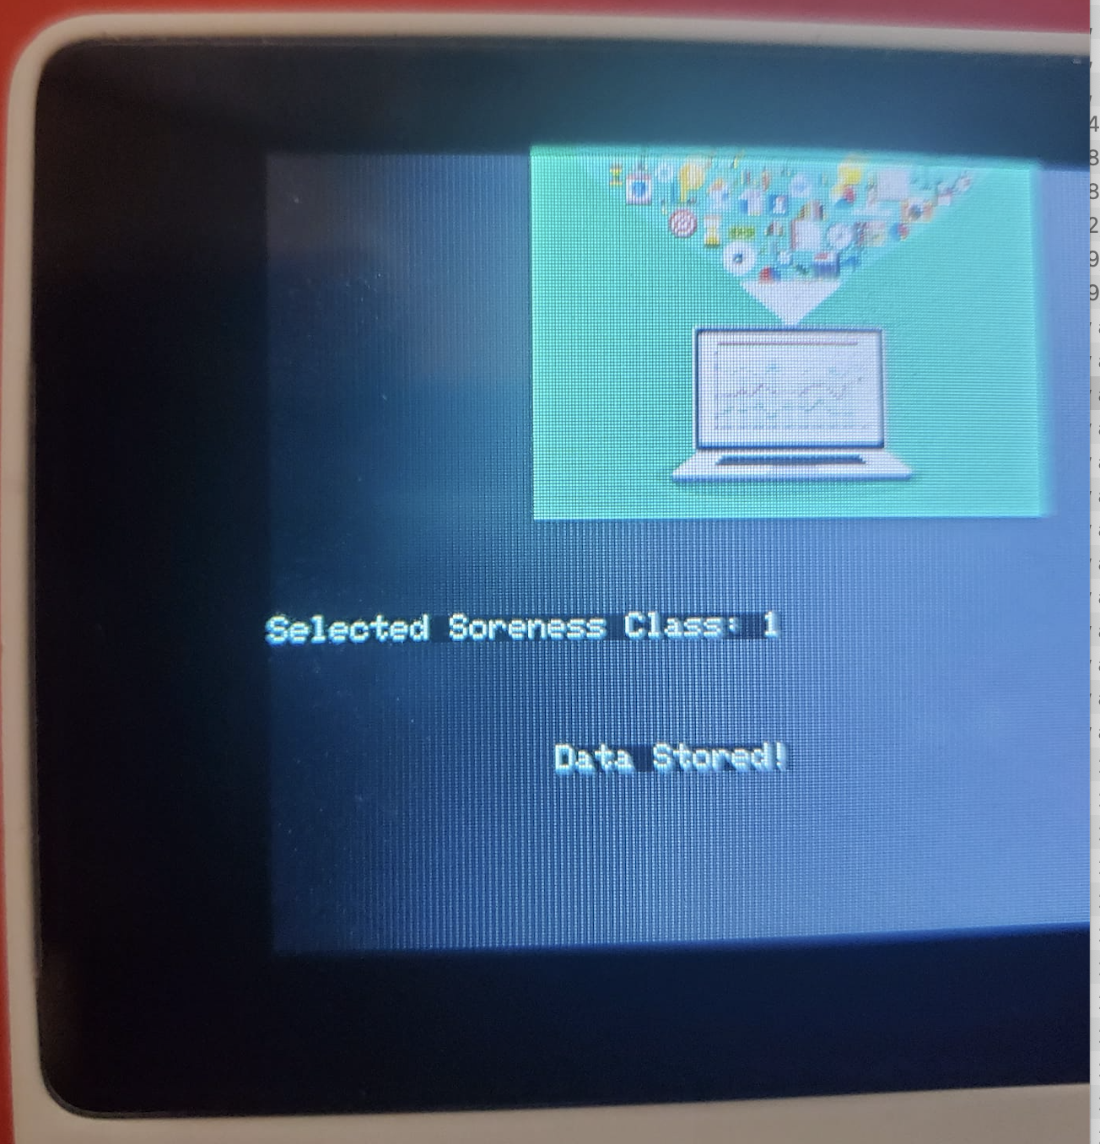
The device displays real-time GSR and EMG measurements as line charts on the TFT screen
If Button B (configurable button) is pressed, the device appends a new row (data record) to the mouse_fatigue_data_set.csv file on the SD card by adding the Tense [1] muscle soreness class under the Soreness data field. Then, if the device saves the data record successfully to the given CSV file on the SD card

Slide 23
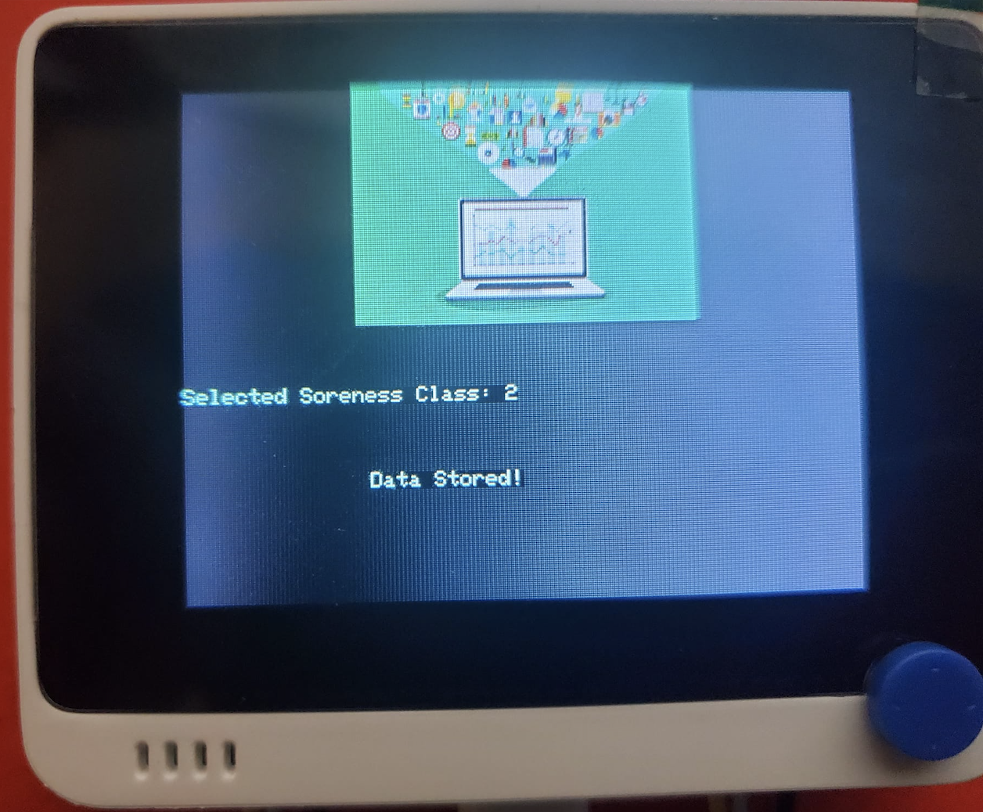
The device displays real-time GSR and EMG measurements as line charts on the TFT screen
If Button C (configurable button) is pressed, the device appends a new row (data record) to the mouse_fatigue_data_set.csv file on the SD card by adding the Exhausted [2] muscle soreness class under the Soreness data field. Then, if the device saves the data record successfully to the given CSV file on the SD card

Slide 24
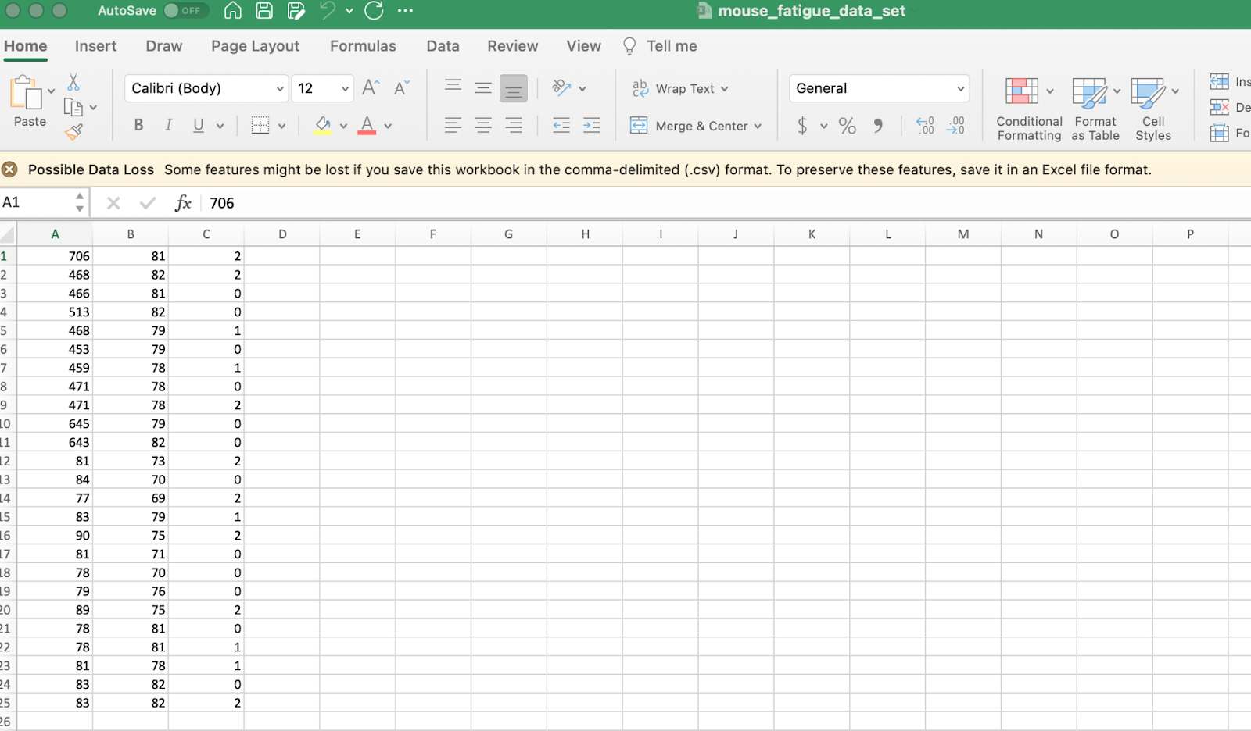
After logging the collected forearm muscle soreness data in a CSV file on the SD card

Slide 25
Run the Python Application
To convert the model from a TensorFlow Keras H5 model to a C array (.h file) so as to run it successfully on Wio Terminal, Run the application in Python. As shown below, the application consists of three code files and three folders:
main.py
test_data.py
tflite_to_c_array.py
/data
/model
/bmp

Slide 26
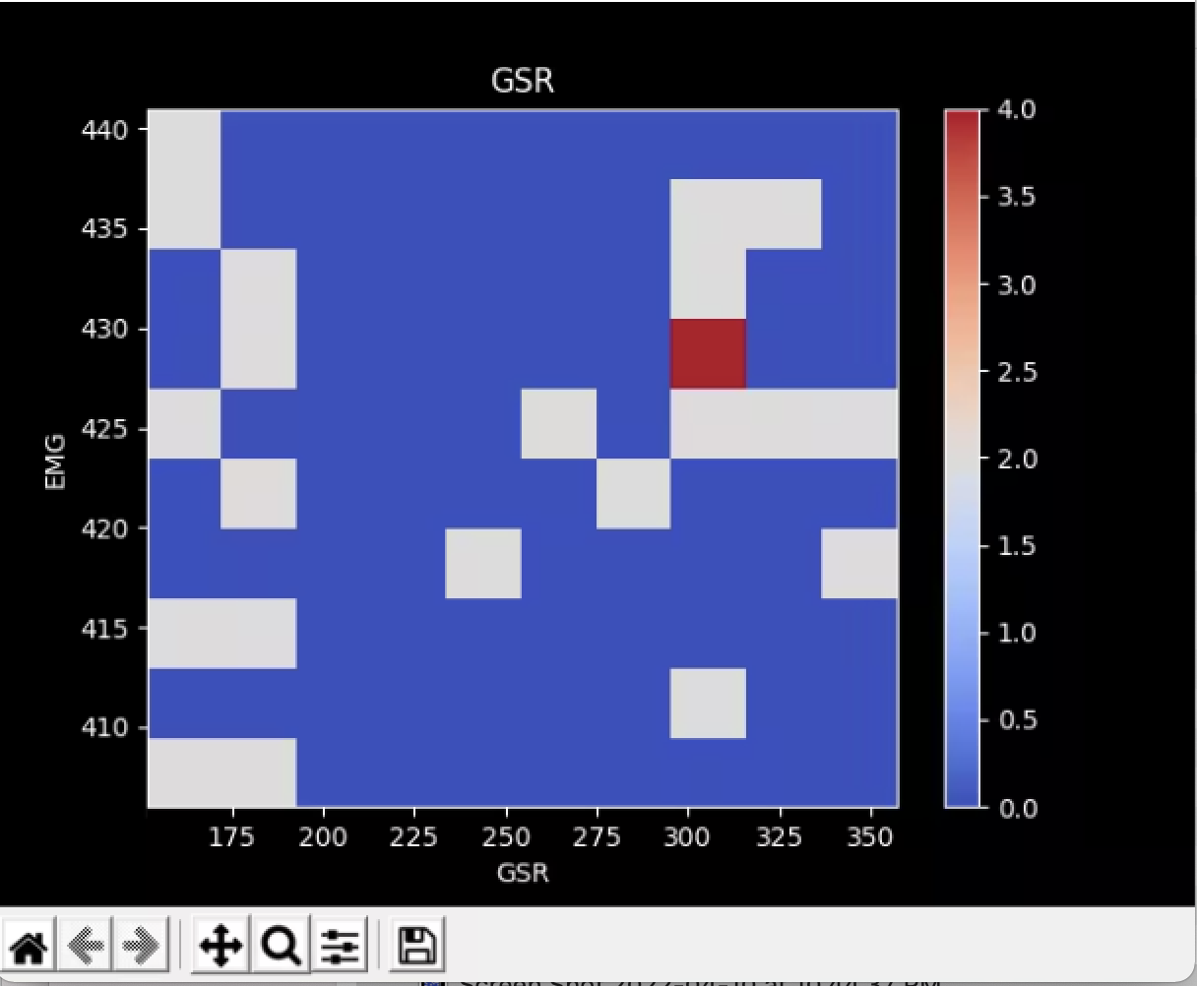
Visualizing the forearm muscle soreness data set
After extracting it from the mouse_fatigue_data_set.csv file saved in the data folder

Slide 27
Assigning labels and scaling (normalizing) data records to create inputs
We create inputs from data records to train the neural network model. Therefore, we utilized these two data elements to create inputs:
GSR
EMG
Then, we scaled (normalized) each data element to format them properly and thus extracted these scaled data elements from the data set for each data record:
scaled_GSR
scaled_EMG
In the scale_data_and_define_inputs function, divide every data element into their required values so as to make them smaller than or equal to 1.
Then, create inputs with the scaled data elements, append them to the inputs array, and convert this array to a NumPy array by using the asarray function.
Each input includes two parameters [shape=(2, )]:
[0.152, 0.407]

Slide 28
Training the model (ANN) on muscle soreness levels (classes)
Since the forearm muscle soreness data set is already limited, We decided to utilize all of the data set as the training data set instead of splitting it into training and testing data sets. Thus, We created a separate testing data set in the test_data.py file.
After defining the training data set, we scaled (normalized) the testing data set inputs to format them appropriately.
Then, We built my artificial neural network model (ANN) by utilizing Keras and trained it with the training set for 150 epochs.
After training with the training set (inputs and labels), the accuracy of the neural network model was between 0.83 and 0.88.

Slide 29
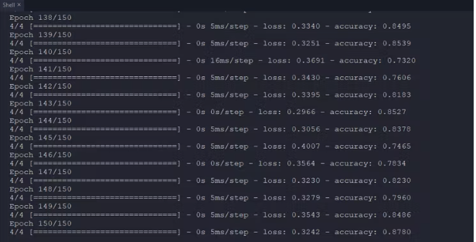
Accuracy of the neural network model was between 0.83 and 0.88.

Slide 30
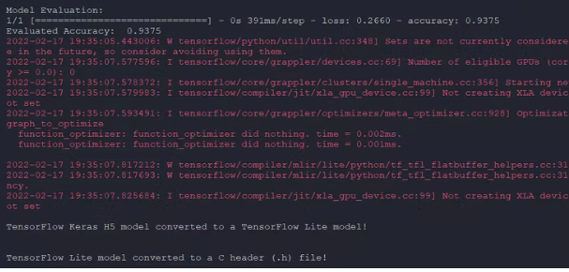
Evaluating the model accuracy and converting the model to a C array
After building and training my artificial neural network model, We tested its accuracy and validity by utilizing the testing data set (inputs and labels).
The evaluated accuracy of the model was 0.9375.

Slide 31
Saved it as a TensorFlow Keras H5 model
After evaluating the neural network model, We saved it as a TensorFlow Keras H5 model (mouse_fatigue_level.h5) to the model folder.
However, running a TensorFlow Keras H5 model on Wio Terminal to make predictions on muscle soreness levels is not eligible and efficient considering size, latency, and power consumption.
Thus, We converted the neural network model from a TensorFlow Keras H5 model (.h5) to a TensorFlow Lite model (.tflite). Then, We modified the TensorFlow Lite model to create a C array (.h file) to run the model on Wio Terminal successfully.

Slide 32
Convert TF model
In the convert_TF_model function, convert the recently trained and evaluated model to a TensorFlow Lite model by applying the TensorFlow Lite converter (tf.lite.TFLiteConverter.from_keras_model).
Then, save the generated TensorFlow Lite model to the model folder (mouse_fatigue_level.tflite).
Modify the saved TensorFlow Lite model to a C array (.h file) by executing the hex_to_c_array function.
Finally, save the generated C array to the model folder (mouse_fatigue_level.h).

Slide 33
Setting up the model on Wio Terminal
After building, training, and converting the neural network model to a C array (.h file), We needed to upload and run the model directly on Wio Terminal so as to create an easy-to-use and capable device without any dependencies.
To download the official TensorFlow library on the Arduino IDE, go to Sketch | Include Library |Manage Libraries… and search for TensorFlow. Then, install the latest version of the Arduino_TensorFlowLite library.

Slide 34
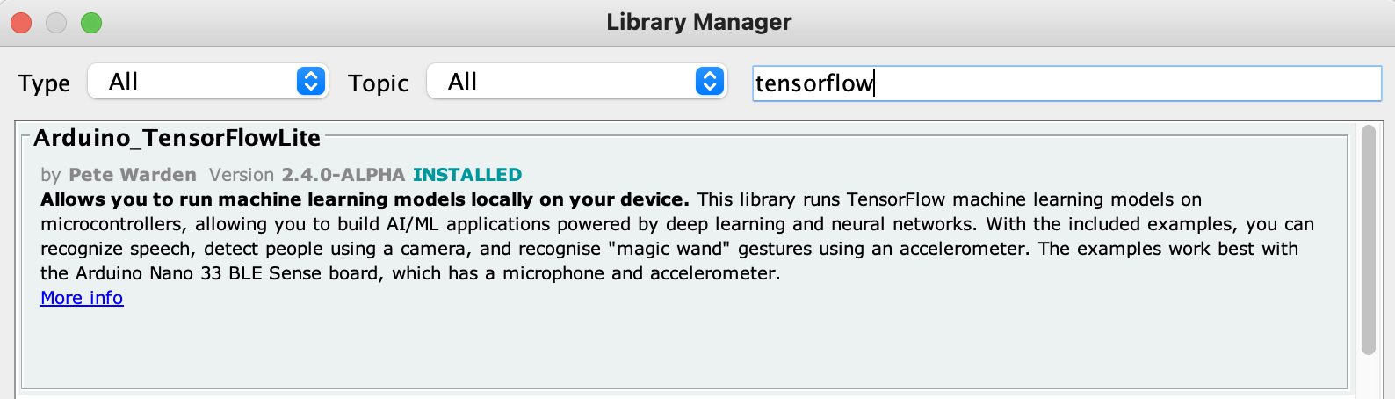
Arduino Tensorflow Lite

Slide 35
Import the neural network model modified as a C array (mouse_fatigue_level.h) to run inferences.
After installing the TensorFlow library on the Arduino IDE, We needed to import the neural network model modified as a C array (mouse_fatigue_level.h) to run inferences.
To import the TensorFlow Lite model converted as a C array (.h file), go to Sketch | Add File...
After importing the converted model (.h file) successfully to the Arduino IDE, We modified the code in to run the neural network model. Then, We employed the 5-way switch integrated into Wio Terminal to run inferences so as to forecast forearm muscle soreness levels

Slide 36
Running the model on Wio Terminal to make predictions on muscle soreness levels
The neural network model predicts possibilities of labels (muscle soreness classes) for each given input as an array of 3 numbers. They represent the model's "confidence" that the given input array corresponds to each of the three different muscle soreness classes based on GSR and EMG measurements [0 - 2], as shown in Step 4:
0 — Relaxed
1 — Tense
2 — Exhausted
After importing and setting up the neural network model as a C array on Wio Terminal successfully, I utilized the model to run inferences to forecast muscle soreness levels.

Slide 37
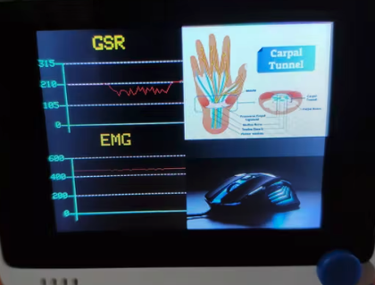
The device displays real-time GSR and EMG measurements as line charts on the TFT screen

Slide 38
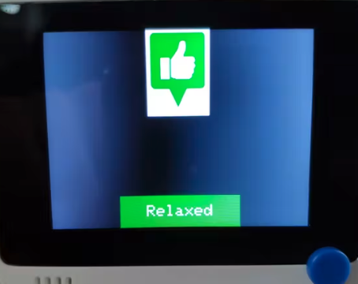
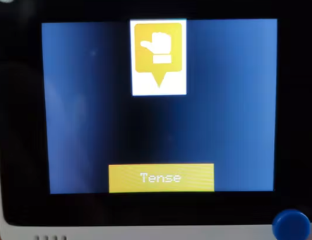
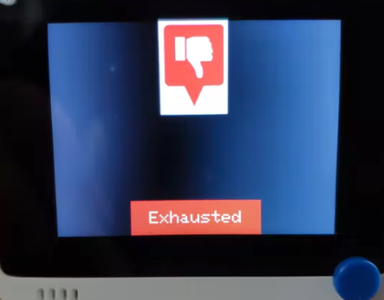
Predicting forearm muscle soreness levels (classes)
the device displays the output, which represents the most accurate label (muscle soreness class) predicted by the model.
Each muscle soreness level (class) has a unique image (16-bit BMP file) and color code to be shown on the TFT screen when being detected as the output:

Slide 39
Conclusion
In summary, our project and research in coordination with Artificial Intelligence combined presented a supervised neural network model with TensorFlow in Python. Furthermore, in combination with Tiny ML Wio Terminal compatible with Arduino, helping to understand how to train and implement a Neural network to predict forearm muscle pain levels using Tiny Machine Learning, Arduino, and Tensorflow Lite.

Slide 40
Accessibility
This simulation will be accessible to the general public at:
https://github.com/lmarinve/mouse-fatigue-detection.git

Slide 41
Citation
Arduino IDE, https://www.arduino.cc/en/software
Getting Started with TinyMl, wiki.seeedstudio.com/Wio-Terminal-TinyML-Kit-Course/
Get started with microcontrollers, www.tensorflow.org/lite/microcontrollers/get_started_low_level
Grove - GSR Sensor, wiki.seeedstudio.com/Grove-GSR_Sensor/
Intro to TinyML Part 1: Training a Model for Arduino in TensorFlow www.digikey.com/en/maker/projects/intro-to-tinyml-part-1-training-a-model-for-arduino-in-tensorflow/8f1fc8c0b83d417ab521c48864d2a8ec
TensorFlow Lite for Microcontrollers, www.tensorflow.org/lite/microcontrollers
TensorFlow Lite converter, www.tensorflow.org/lite/convert
Machine Learning vs Neural Networks: Why It's Not One or the Other
www.verypossible.com/insights/machine-learning-vs.-neural-networks#:~:text=Strictly%20speaking%2C%20a%20neural%20network,usually%20used%20in%20supervised%20learning.

